Slide 1

TKINTER

Slide 2
TKINTER
Most of the programs we have done till now are text-based programming. But many applications need GUI (Graphical User Interface).
Python provides several different options for writing GUI based programs. These are listed below:
Tkinter
Jpython
wxpython
Tkinter: It is easiest to start with. Tkinter is Python's standard GUI (graphical user interface) package. It is the most commonly used toolkit for GUI programming in Python.

Slide 3
JPython: It is the Python platform for Java that is providing Python scripts seamless access o Java class Libraries for the local machine.
wxPython: It is an open-source, cross-platform GUI toolkit written in C++. It is one of the alternatives to Tkinter, which is bundled with Python.
There are many other interfaces available for GUI. But these are the most commonly used ones. In this, we will learn about the basic GUI programming using Tkinter.

Slide 4
TO CREATE A TKINTER APP:
Importing the module – tkinter
Create the main window (container)
Add any number of widgets to the main window
Apply the event Trigger on the widgets.
Importing tkinter is same as importing any other module in the Python code. Note that the name of the module in Python 2.x is ‘Tkinter’ and in Python 3.x it is ‘tkinter’.

Slide 5
TKINTER METHODS
There are two main methods used which the user needs to remember while creating the Python application with GUI.
To create a main window, tkinter offers a method Tk() . The basic code used to create the main window of the application is:
There is another method known by the name mainloop() is used when your application is ready to run. mainloop() is an infinite loop used to run the application, wait for an event to occur and process the event as long as the window is not closed.

Slide 6
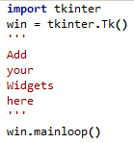
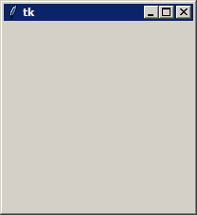
CREATE A WINDOW

Slide 7
WIDGETS
label
button
canvas
combo-box
frame
check-button
entry
label-frame
menu
list - box
menu button
message
tk_optionMenu
progress-bar
radio button
scroll bar
separator
tree-view

Slide 8
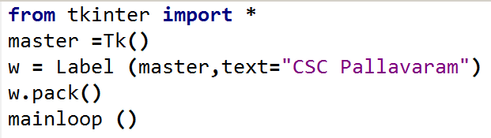

LABEL

Slide 9
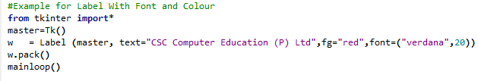

EXAMPLE

Slide 10
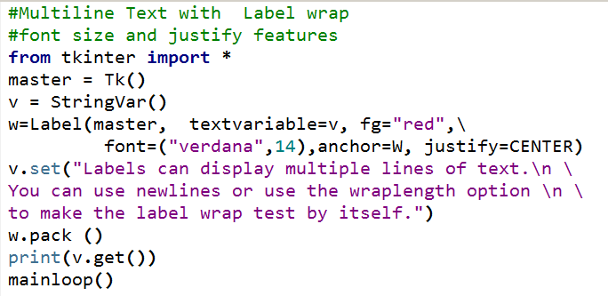
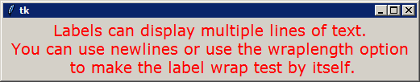
EXAMPLE

Slide 11
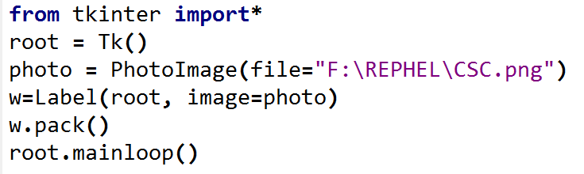

PHOTO IMAGE

Slide 12
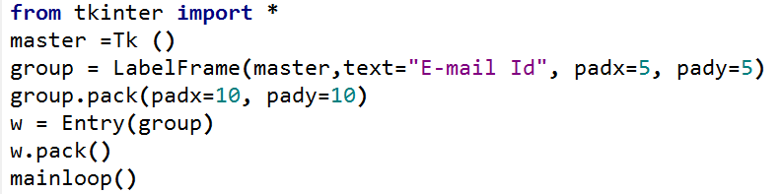

LABEL FRAME

Slide 13
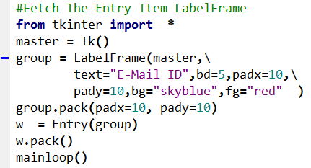
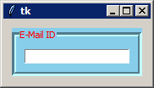
EXAMPLE

Slide 14
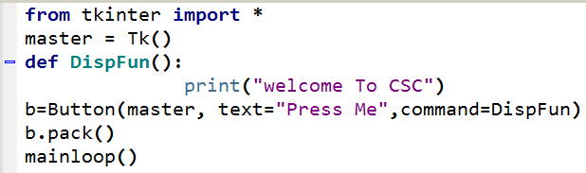


BUTTON WIDGET

Slide 15
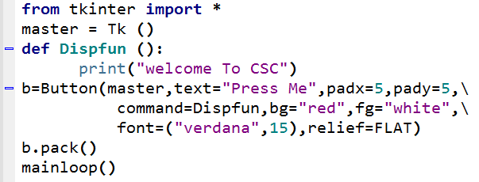

EXAMPLE

Slide 19
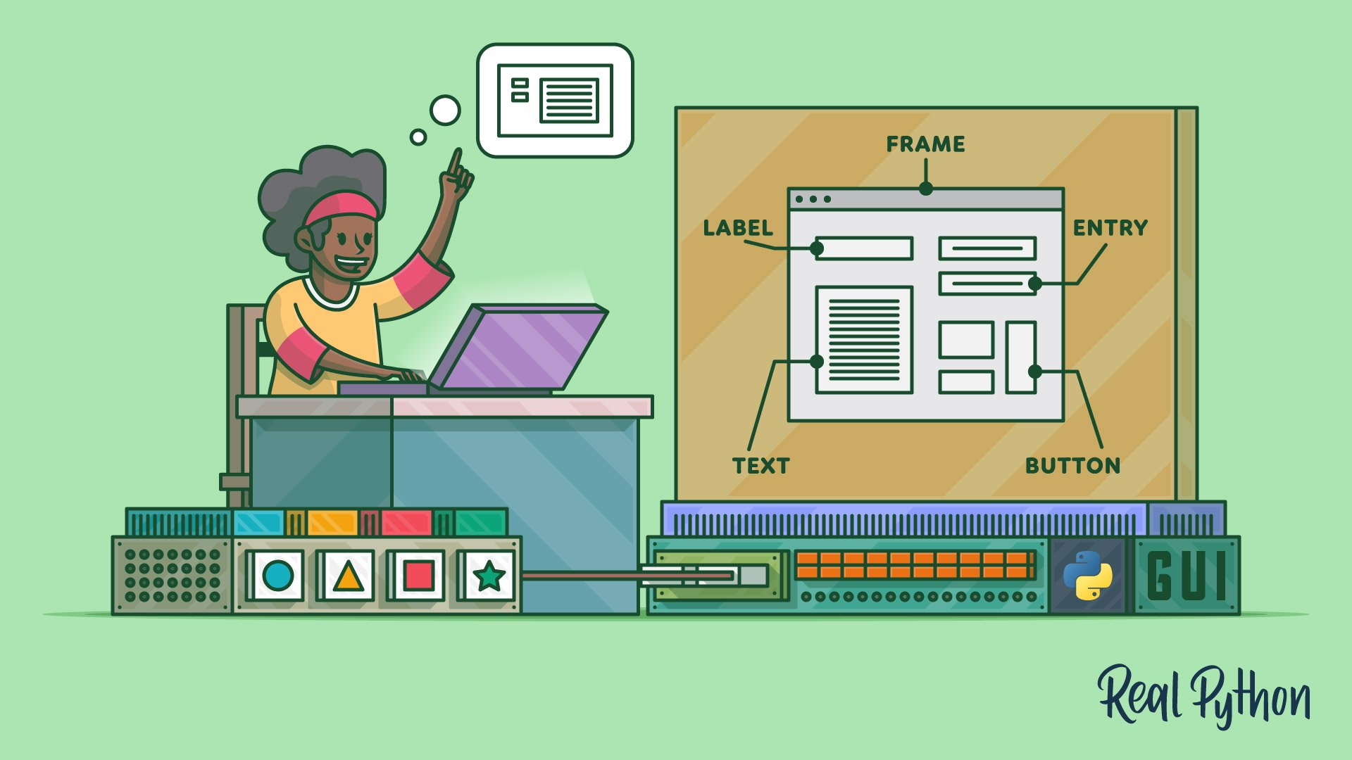
CODING IS FUN ! THANK YOU !!

